Slide 1


Arrays in Python (Cont.)

Slide 2

Learning Objective
In this lecture, we will learn how to create arrays in Python using NumPy package, what functions are available for creating different kinds of arrays and which operations we can perform on numpy arrays.
Notes:
After this lecture, you shall be able to Explain why we need variables and what is their relation to the memory.

Slide 3
Creating Arrays from ranges?
Using the numpy library functions, we can create arrays from different ranges. A range is a collection of all values within a specified minimum and maximum value. (lower and upper bound)
i.e. if we say range(5, 10) then all numbers {5, 6, 7, 8, 9} will be in this range.
Maximum value (upper bound) is never included by default.
Notes:
Programming sekhny ka maksad hia k ham apni real life problem computer ki madad sy solve ker sakhain.
Ham apni roz mara zindagi main bhot sary decision conditions ki base per lyty hain jesy k
Agr kal barish hoi to ham pick nick per jain gy
Agr aaj school ki chuti hoi to main cartoon daikoun ga
Or Agr kal mjy job mill gi to main aap ko party doun ga.
In conditions ko programming main handel kerny k leay conditional structure use hoty hain.

Slide 4
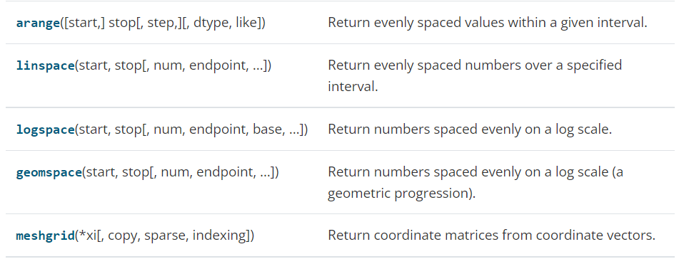
Creating Arrays from ranges?
Let’s look at the functions which can help us in generating arrays by specifying different ranges.
Numpy provides following functions:
Notes:
Programming sekhny ka maksad hia k ham apni real life problem computer ki madad sy solve ker sakhain.
Ham apni roz mara zindagi main bhot sary decision conditions ki base per lyty hain jesy k
Agr kal barish hoi to ham pick nick per jain gy
Agr aaj school ki chuti hoi to main cartoon daikoun ga
Or Agr kal mjy job mill gi to main aap ko party doun ga.
In conditions ko programming main handel kerny k leay conditional structure use hoty hain.

Slide 5
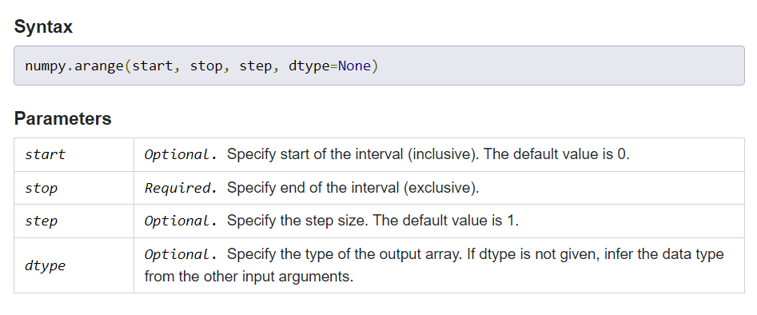
arange() function in Numpy
The arange() works like the range function in python. It is used to create a list of integers within the range of numbers.

Slide 6
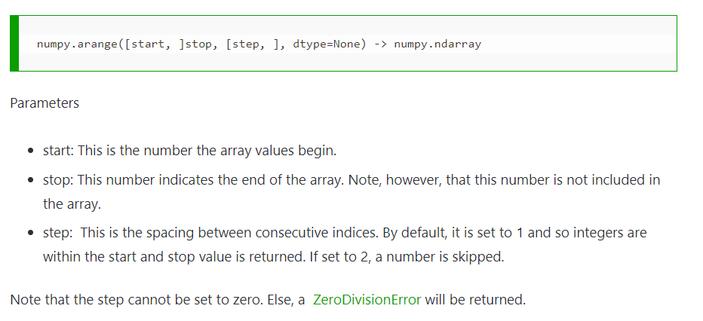
arange() function in Numpy
The arange() works like the range function in python. It is used to create a list of integers within the range of numbers.

Slide 7
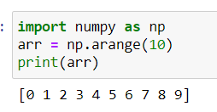
arange() function in Numpy
Example 1: only using the required attribute (stop).
If we only specify stop attribute, then it will create array starting from zero till the stop value (stop value will not be included).
Notes:
Programming sekhny ka maksad hia k ham apni real life problem computer ki madad sy solve ker sakhain.
Ham apni roz mara zindagi main bhot sary decision conditions ki base per lyty hain jesy k
Agr kal barish hoi to ham pick nick per jain gy
Agr aaj school ki chuti hoi to main cartoon daikoun ga
Or Agr kal mjy job mill gi to main aap ko party doun ga.
In conditions ko programming main handel kerny k leay conditional structure use hoty hain.

Slide 8
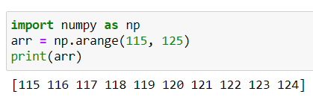
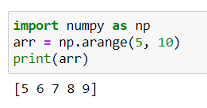
arange() function in Numpy
Example 2: Using start and stop attributes.
The array will be created starting from start value and will end at stop value with the difference of 1 between any two consecutive array values.
Notes:
Programming sekhny ka maksad hia k ham apni real life problem computer ki madad sy solve ker sakhain.
Ham apni roz mara zindagi main bhot sary decision conditions ki base per lyty hain jesy k
Agr kal barish hoi to ham pick nick per jain gy
Agr aaj school ki chuti hoi to main cartoon daikoun ga
Or Agr kal mjy job mill gi to main aap ko party doun ga.
In conditions ko programming main handel kerny k leay conditional structure use hoty hain.

Slide 9
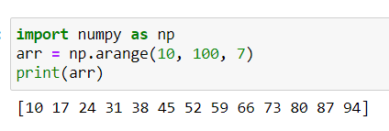
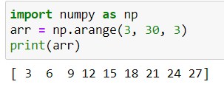
arange() function in Numpy
Example 3: Using all 3 attributes (start, stop, step).
The array will be created starting from start value and will end at stop value with the difference of value given in step between any two consecutive array values.
Notes:
Programming sekhny ka maksad hia k ham apni real life problem computer ki madad sy solve ker sakhain.
Ham apni roz mara zindagi main bhot sary decision conditions ki base per lyty hain jesy k
Agr kal barish hoi to ham pick nick per jain gy
Agr aaj school ki chuti hoi to main cartoon daikoun ga
Or Agr kal mjy job mill gi to main aap ko party doun ga.
In conditions ko programming main handel kerny k leay conditional structure use hoty hain.

Slide 10
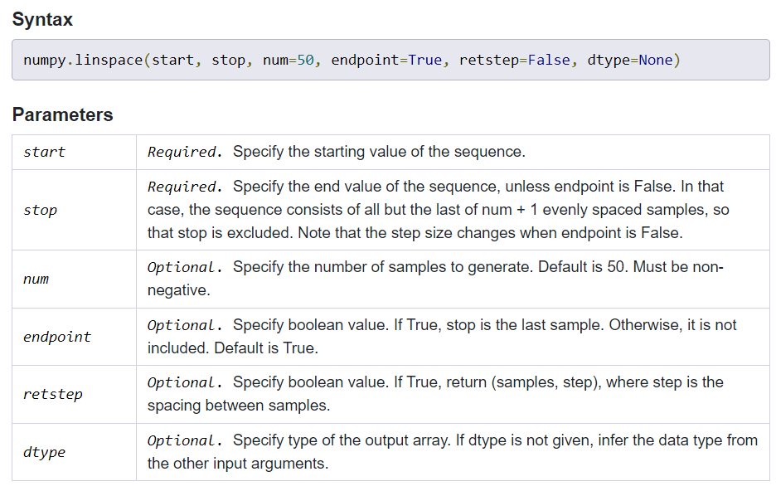
linspace() function in Numpy
The numpy.linspace() function returns evenly spaced values over a specified interval. The values are generated in the range [start, stop] with specified number of samples. The endpoint of the interval can optionally be excluded.
Notes:
Programming sekhny ka maksad hia k ham apni real life problem computer ki madad sy solve ker sakhain.
Ham apni roz mara zindagi main bhot sary decision conditions ki base per lyty hain jesy k
Agr kal barish hoi to ham pick nick per jain gy
Agr aaj school ki chuti hoi to main cartoon daikoun ga
Or Agr kal mjy job mill gi to main aap ko party doun ga.
In conditions ko programming main handel kerny k leay conditional structure use hoty hain.

Slide 11
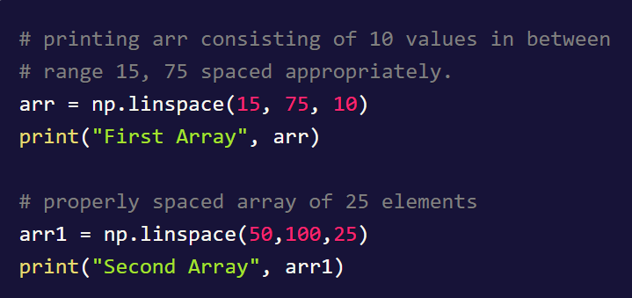
linspace() function in Numpy
Example: linspace(start, stop, samples)
Notes:
Programming sekhny ka maksad hia k ham apni real life problem computer ki madad sy solve ker sakhain.
Ham apni roz mara zindagi main bhot sary decision conditions ki base per lyty hain jesy k
Agr kal barish hoi to ham pick nick per jain gy
Agr aaj school ki chuti hoi to main cartoon daikoun ga
Or Agr kal mjy job mill gi to main aap ko party doun ga.
In conditions ko programming main handel kerny k leay conditional structure use hoty hain.

Slide 12
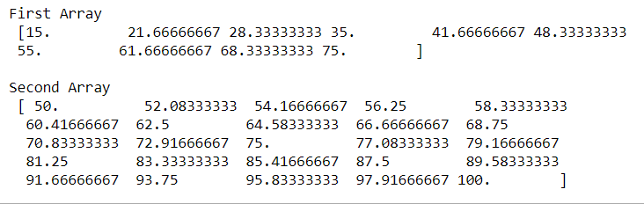
linspace() function in Numpy
Example: Output
Notes:
Programming sekhny ka maksad hia k ham apni real life problem computer ki madad sy solve ker sakhain.
Ham apni roz mara zindagi main bhot sary decision conditions ki base per lyty hain jesy k
Agr kal barish hoi to ham pick nick per jain gy
Agr aaj school ki chuti hoi to main cartoon daikoun ga
Or Agr kal mjy job mill gi to main aap ko party doun ga.
In conditions ko programming main handel kerny k leay conditional structure use hoty hain.

Slide 13
Indexing and slicing Arrays in Python?
Indexing: Arrays can be indexed using the standard Python x[obj] syntax, where x is the array and obj the selection.
There are three kinds of indexing available:
field access
basic slicing
advanced indexing
Notes:
Programming sekhny ka maksad hia k ham apni real life problem computer ki madad sy solve ker sakhain.
Ham apni roz mara zindagi main bhot sary decision conditions ki base per lyty hain jesy k
Agr kal barish hoi to ham pick nick per jain gy
Agr aaj school ki chuti hoi to main cartoon daikoun ga
Or Agr kal mjy job mill gi to main aap ko party doun ga.
In conditions ko programming main handel kerny k leay conditional structure use hoty hain.

Slide 14
Indexing and slicing Arrays in Python?
Field access: If the array object is a structured array the fields of the array can be accessed by indexing the array with strings, dictionary-like.
Here x is a one-dimensional array of length two whose datatype is a structure with three fields:
A string of length 10 or less named ‘name’,
A 32-bit integer named ‘age’, and
A 32-bit float named ‘weight’.
Notes:
Programming sekhny ka maksad hia k ham apni real life problem computer ki madad sy solve ker sakhain.
Ham apni roz mara zindagi main bhot sary decision conditions ki base per lyty hain jesy k
Agr kal barish hoi to ham pick nick per jain gy
Agr aaj school ki chuti hoi to main cartoon daikoun ga
Or Agr kal mjy job mill gi to main aap ko party doun ga.
In conditions ko programming main handel kerny k leay conditional structure use hoty hain.

Slide 15

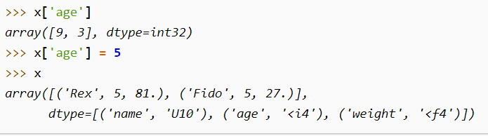
Indexing and slicing Arrays in Python?
If you index x at position 1 you get a structure
You can access and modify individual fields of a structured array by indexing with the field name like
Notes:
Programming sekhny ka maksad hia k ham apni real life problem computer ki madad sy solve ker sakhain.
Ham apni roz mara zindagi main bhot sary decision conditions ki base per lyty hain jesy k
Agr kal barish hoi to ham pick nick per jain gy
Agr aaj school ki chuti hoi to main cartoon daikoun ga
Or Agr kal mjy job mill gi to main aap ko party doun ga.
In conditions ko programming main handel kerny k leay conditional structure use hoty hain.

Slide 16
Indexing and slicing Arrays in Python?
Slicing: in python means taking elements from one given index to another given index.
We pass slice instead of index like this: [start:end].
We can also define the step, like this: [start:end:step].
If we don't pass start its considered 0
If we don't pass end its considered length of array in that dimension
If we don't pass step its considered 1
Notes:
Programming sekhny ka maksad hia k ham apni real life problem computer ki madad sy solve ker sakhain.
Ham apni roz mara zindagi main bhot sary decision conditions ki base per lyty hain jesy k
Agr kal barish hoi to ham pick nick per jain gy
Agr aaj school ki chuti hoi to main cartoon daikoun ga
Or Agr kal mjy job mill gi to main aap ko party doun ga.
In conditions ko programming main handel kerny k leay conditional structure use hoty hain.

Slide 17
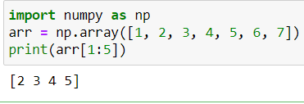
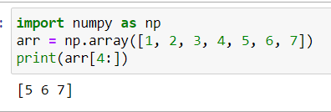
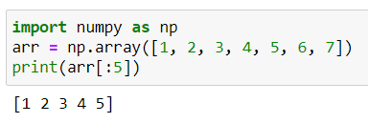
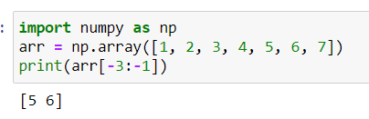
Indexing and slicing Arrays in Python?
Slicing example 1: Example 2:
Example 3: Example 4:
Notes:
Programming sekhny ka maksad hia k ham apni real life problem computer ki madad sy solve ker sakhain.
Ham apni roz mara zindagi main bhot sary decision conditions ki base per lyty hain jesy k
Agr kal barish hoi to ham pick nick per jain gy
Agr aaj school ki chuti hoi to main cartoon daikoun ga
Or Agr kal mjy job mill gi to main aap ko party doun ga.
In conditions ko programming main handel kerny k leay conditional structure use hoty hain.

Slide 18
Indexing and slicing Arrays in Python?
Slicing in 2-D Arrays: we use commas to separate multiple arrays for slicing.
For example, we have following 2D array.
arr = np.array([[10, 11, 12, 13], [20, 21, 22, 23]])
To get values from second array we’ll use this.
Arr[1, 2:]
This will print all values from second array starting from index 2 of the array till end.
Notes:
Programming sekhny ka maksad hia k ham apni real life problem computer ki madad sy solve ker sakhain.
Ham apni roz mara zindagi main bhot sary decision conditions ki base per lyty hain jesy k
Agr kal barish hoi to ham pick nick per jain gy
Agr aaj school ki chuti hoi to main cartoon daikoun ga
Or Agr kal mjy job mill gi to main aap ko party doun ga.
In conditions ko programming main handel kerny k leay conditional structure use hoty hain.

Slide 19
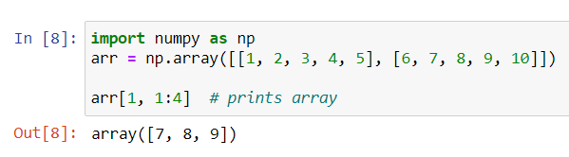
Indexing and slicing Arrays in Python?
Example 1: From the second element, slice elements from index 1 to index 4 (not included)
Notes:
Programming sekhny ka maksad hia k ham apni real life problem computer ki madad sy solve ker sakhain.
Ham apni roz mara zindagi main bhot sary decision conditions ki base per lyty hain jesy k
Agr kal barish hoi to ham pick nick per jain gy
Agr aaj school ki chuti hoi to main cartoon daikoun ga
Or Agr kal mjy job mill gi to main aap ko party doun ga.
In conditions ko programming main handel kerny k leay conditional structure use hoty hain.

Slide 20
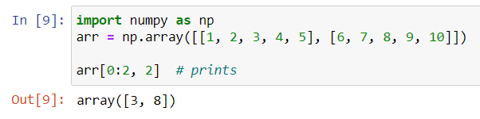
Indexing and slicing Arrays in Python?
Example 2: From both elements, return index 2
Notes:
Programming sekhny ka maksad hia k ham apni real life problem computer ki madad sy solve ker sakhain.
Ham apni roz mara zindagi main bhot sary decision conditions ki base per lyty hain jesy k
Agr kal barish hoi to ham pick nick per jain gy
Agr aaj school ki chuti hoi to main cartoon daikoun ga
Or Agr kal mjy job mill gi to main aap ko party doun ga.
In conditions ko programming main handel kerny k leay conditional structure use hoty hain.

Slide 21
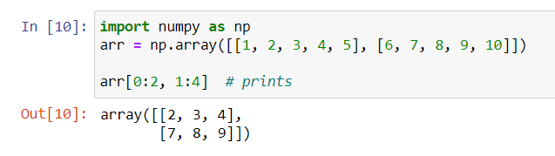
Indexing and slicing Arrays in Python?
Example 3: From both elements, slice index 1 to index 4 (not included), this will return a 2-D array.
Notes:
Programming sekhny ka maksad hia k ham apni real life problem computer ki madad sy solve ker sakhain.
Ham apni roz mara zindagi main bhot sary decision conditions ki base per lyty hain jesy k
Agr kal barish hoi to ham pick nick per jain gy
Agr aaj school ki chuti hoi to main cartoon daikoun ga
Or Agr kal mjy job mill gi to main aap ko party doun ga.
In conditions ko programming main handel kerny k leay conditional structure use hoty hain.

Slide 22
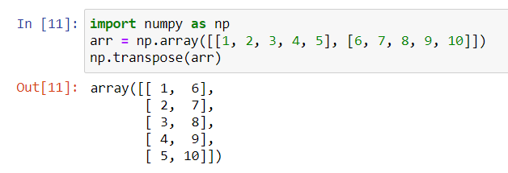
Reshaping and Transposing
Transposing: Reversing the dimensions of an array is called transposing.
Numpy library provides a function which takes an array as input and changes it’s dimensions.

Slide 23
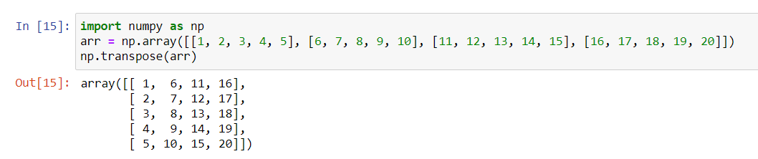
Reshaping and Transposing
Example: A 4-D array is transposed
Notes:
Programming sekhny ka maksad hia k ham apni real life problem computer ki madad sy solve ker sakhain.
Ham apni roz mara zindagi main bhot sary decision conditions ki base per lyty hain jesy k
Agr kal barish hoi to ham pick nick per jain gy
Agr aaj school ki chuti hoi to main cartoon daikoun ga
Or Agr kal mjy job mill gi to main aap ko party doun ga.
In conditions ko programming main handel kerny k leay conditional structure use hoty hain.

Slide 24
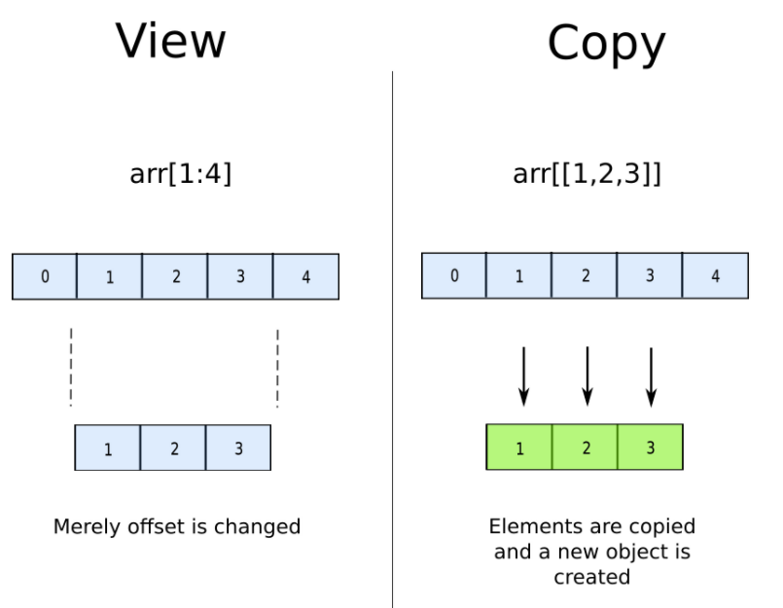
Views vs Copy
The main difference between a copy and a view of an array is that the copy is a new array, and the view is just a view of the original array.
Notes:
Programming sekhny ka maksad hia k ham apni real life problem computer ki madad sy solve ker sakhain.
Ham apni roz mara zindagi main bhot sary decision conditions ki base per lyty hain jesy k
Agr kal barish hoi to ham pick nick per jain gy
Agr aaj school ki chuti hoi to main cartoon daikoun ga
Or Agr kal mjy job mill gi to main aap ko party doun ga.
In conditions ko programming main handel kerny k leay conditional structure use hoty hain.

Slide 25
Views vs Copy
Main Difference:
The copy owns the data and any changes made to the copy will not affect original array, and any changes made to the original array will not affect the copy.
The view does not own the data and any changes made to the view will affect the original array, and any changes made to the original array will affect the view.
Notes:
Programming sekhny ka maksad hia k ham apni real life problem computer ki madad sy solve ker sakhain.
Ham apni roz mara zindagi main bhot sary decision conditions ki base per lyty hain jesy k
Agr kal barish hoi to ham pick nick per jain gy
Agr aaj school ki chuti hoi to main cartoon daikoun ga
Or Agr kal mjy job mill gi to main aap ko party doun ga.
In conditions ko programming main handel kerny k leay conditional structure use hoty hain.

Slide 26
Views vs Copy
Main Difference:
The copy owns the data and any changes made to the copy will not affect original array, and any changes made to the original array will not affect the copy.
The view does not own the data and any changes made to the view will affect the original array, and any changes made to the original array will affect the view.
Notes:
Programming sekhny ka maksad hia k ham apni real life problem computer ki madad sy solve ker sakhain.
Ham apni roz mara zindagi main bhot sary decision conditions ki base per lyty hain jesy k
Agr kal barish hoi to ham pick nick per jain gy
Agr aaj school ki chuti hoi to main cartoon daikoun ga
Or Agr kal mjy job mill gi to main aap ko party doun ga.
In conditions ko programming main handel kerny k leay conditional structure use hoty hain.

Slide 27
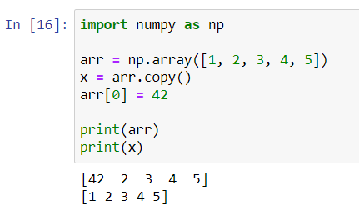
Views vs Copy
Example:
Notes:
Programming sekhny ka maksad hia k ham apni real life problem computer ki madad sy solve ker sakhain.
Ham apni roz mara zindagi main bhot sary decision conditions ki base per lyty hain jesy k
Agr kal barish hoi to ham pick nick per jain gy
Agr aaj school ki chuti hoi to main cartoon daikoun ga
Or Agr kal mjy job mill gi to main aap ko party doun ga.
In conditions ko programming main handel kerny k leay conditional structure use hoty hain.

Slide 28

Self Assessment
Solve the Following Programs
Write a program to create an array from 10 to 20.
Write a program to create an array from 0 to 100 with difference of 5.
Write a program to create an array from 20 to 30 with 100 evenly spaced values.

Slide 29
Self Assessment
Solve Following Programs
Given the following array [12, 15, 18, 21, 24, 27, 30]. Create a new array starting from value 21 to 27.
Given the following array [12, 15, 18, 21, 24, 27, 30, 40, 50, 60]. Create a new array starting from value 40 to the end of array.

Slide 30
Self Assessment
Solve Following Programs
Given the following 2-D array [[1,2,3,4,5,6],[9,8,7,6,5,4]]. Create a program which prints 3rd element from each array (as new array).
Take the 2D array from Question 1 and change the shape of the array.

